Slide 1

What is Knowledge?
Summer Preparation - Philosophy

Slide 2
The Study of Knowledge
The study of knowledge is called: Epistemology
Knowledge =
  more than belief or suppositions
  something absolute
  cannot be logically disputed
There are different views on how we can gain knowledge:
Rationalism –
  Knowledge is gained through reason / logic alone
  No reference to the empirical world is required
Empiricism –
  Knowledge is gained through sensory experience of the world
  E.g. scientific investigation

Slide 3

Philosophical Vocabulary – Activity 1
Read the worksheet provided
Find out the meaning of the following words and write a glossary definition for each one:
Valid
Sound
Syllogism
Deductive
Inductive
A priori
A posteriori

Slide 4

Activity 2:
Read the following examples of syllogistic arguments and decide:
Which are not valid? Why?
Which are not sound? Why?
Write out your answers for each example
Go to Q1
Go to Q2
Go to Q3
Go to Q4
Go to Q5
Go to Q6
Go to Q7
Go to Q8

Slide 5

Q1
All books from that store are new
These books are from that store
Therefore these books are new
For a reminder of what to do, click here:

Slide 6

Q2
Some mugs are beautiful
All mugs are useful
All useful things are beautiful
For a reminder of what to do, click here:

Slide 7

Q3
All coloured flowers are scented
No scented flowers are grown indoors
No flowers grown indoors are coloured
For a reminder of what to do, click here:

Slide 8
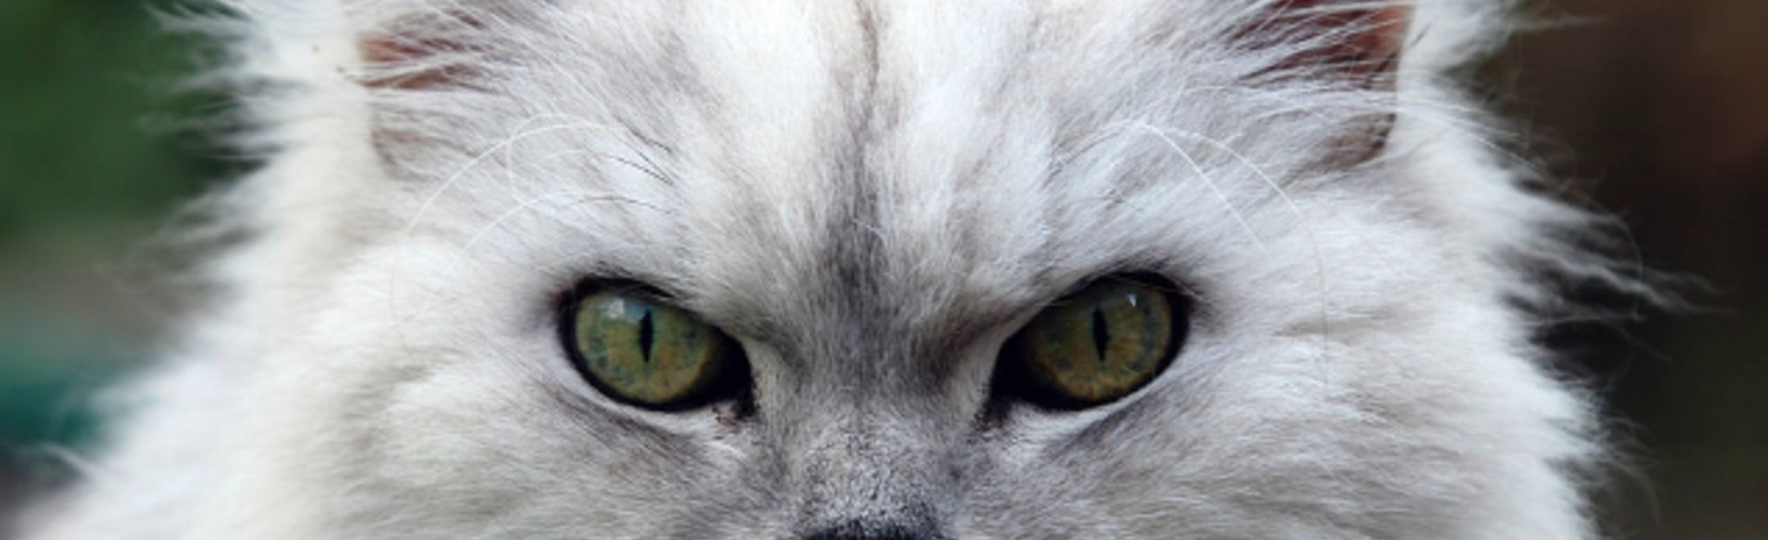
Q4
Some cats have no tails
All cats are mammals
Mammals do not have tails
For a reminder of what to do, click here:

Slide 9
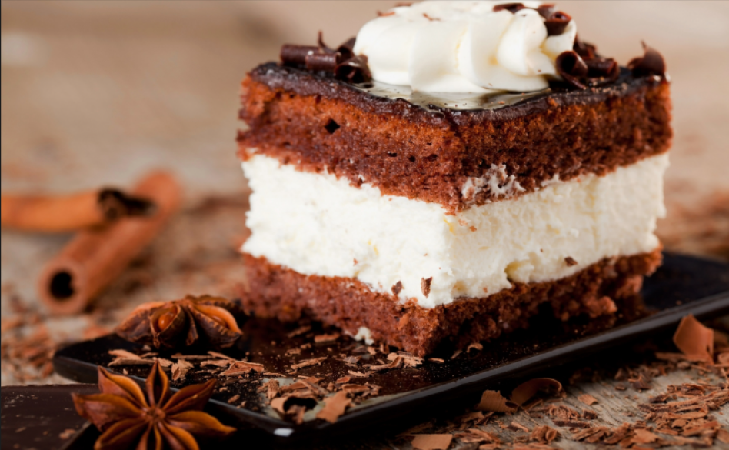
Q5
No healthy food is fattening
All cakes are fattening
No cakes are healthy
For a reminder of what to do, click here:

Slide 10

Q6
No lazy people pass exams
Some students pass exams
Some students are not lazy
For a reminder of what to do, click here:

Slide 11

Everything has a cause
The world is a ‘thing’
The world is caused
Q7
For a reminder of what to do, click here:

Slide 12

Q8
All complex things are designed
The universe is a complex thing
The universe is designed
For a reminder of what to do, click here:

Slide 13

Deductive Arguments
An argument in which the premises lead indisputably to the conclusion
If the premises are true and the logic is valid, then the conclusion must be true
It is illogical to accept the premises but not the conclusion of a deductive argument

Slide 14

Inductive Arguments
An argument in which the premises lead to a conclusion which is possible but not the only possibility
Here we must ask:
  Are the premises true?
  Is the argument valid?
  How persuasive is it?

Slide 15

Philosophical Proofs
Arguments for the existence of God that claim to be valid and sound
We will be considering:
  The cosmological argument
  The teleological argument
  The ontological argument

Slide 16

A Priori Arguments
Based on acquired knowledge without, independent of or prior to experience
Rationalist
Relies on logic and reasoning
No empirical evidence
The ontological argument

Slide 17

A Posteriori Arguments
Based on experience
Uses reason based on human experience of the world
Empiricist
Relies on empirical evidence
The cosmological argument
The teleological argument

Slide 18

Vocabulary you need to know:
Epistemology – The theory of / study of knowledge
Rationalism – The view that the dominant foundation of knowledge is reason
Empiricism – The view that the dominant foundation of knowledge is experience
For more vocabulary you need to know, click here:

Slide 19
Vocabulary you need to know:
Valid – An argument where there are no mistakes in logic
Sound – Where the logic is correct, and the premises are true
Syllogism – a three-line argument in which a conclusion is derived from two premises
For more vocabulary you need to know, click here:

Slide 20
Vocabulary you need to know:
Deductive – An argument in which, if the premises are true, then the conclusion must be true
Inductive – An argument constructed on true premises reaching a logically possible and persuasive conclusion
A priori – Without or prior to experience; used of an argument which is based on acquired knowledge independent of or prior to experience
A posteriori – Based on experience; used of an argument which is based on experience or empirical evidence

