Slide 1

Why you should study travel & tourism

Slide 2
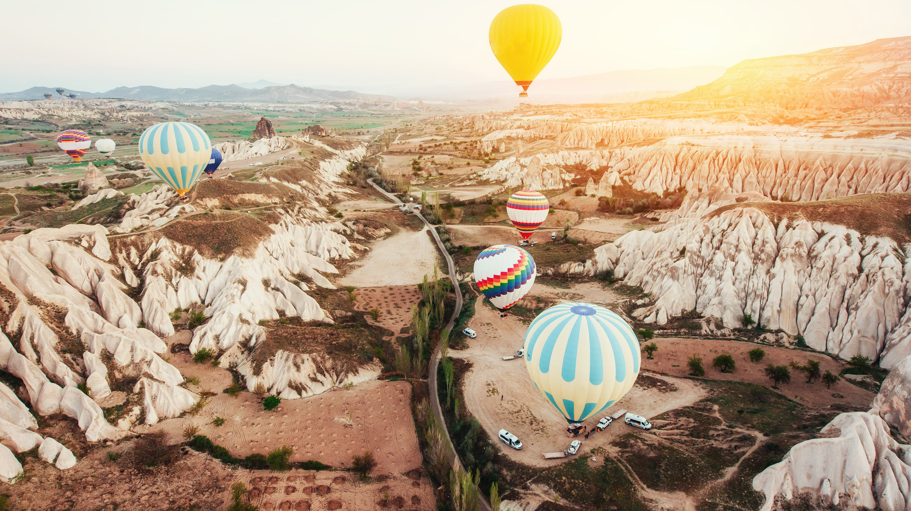
Travel and tourism is the most exciting industry in the world.

Slide 3
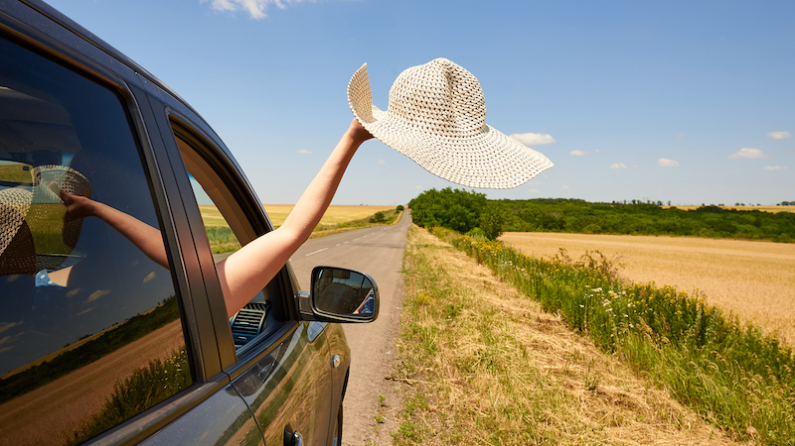
No two days in the travel industry are ever the same.

Slide 4
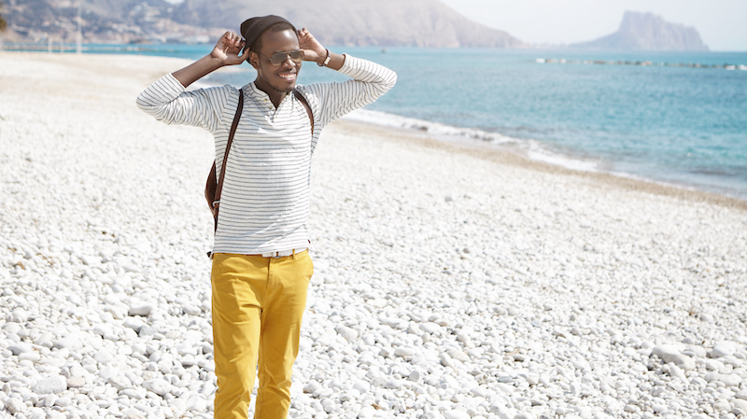
Do you get bored easily?
Don’t fancy sitting at an office desk all day?
Then travel and tourism is the place for you!

Slide 5
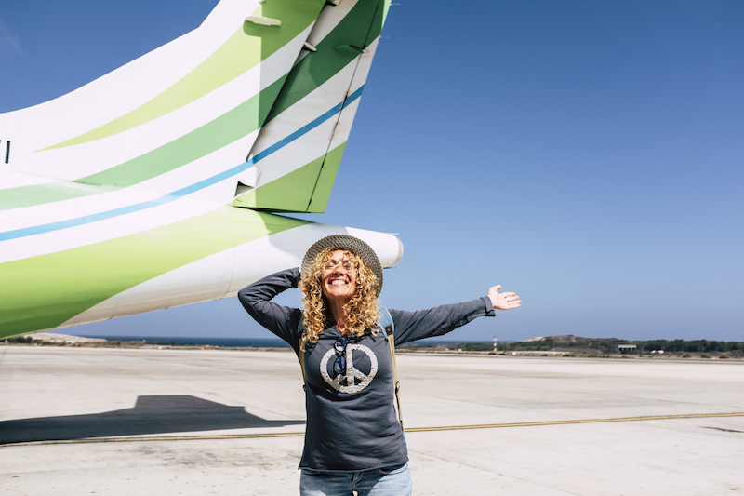
Do you love travel?
Human beings have a natural desire travel and to explore.
Studying travel and tourism can help inspire this inner wanderlust.
You will learn about the most incredible places in the world, the hidden treasures and the most beautiful corners of the globe.
You are introduced to new cultures and new ways of life.
You will learn how to make the most of this incredible planet that we live on and to help others to do this too!

Slide 6
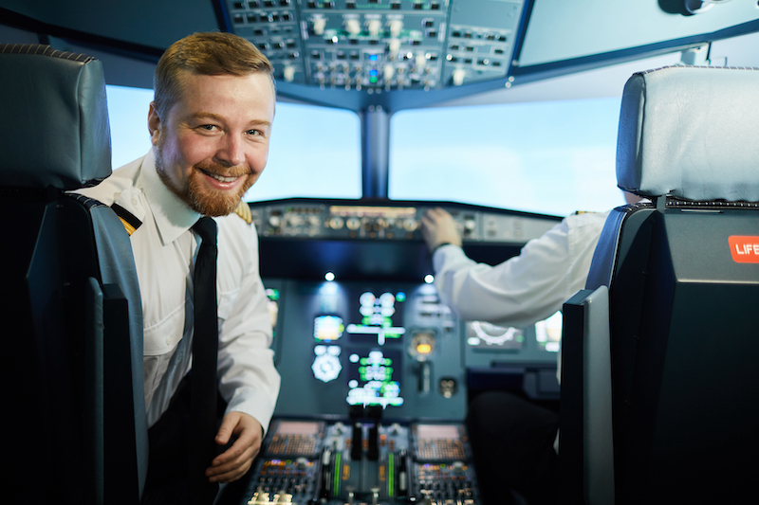
There are plenty of jobs
Travel and tourism is the biggest industry in the entire world employing around 25% of the global workforce.
Travel and tourism is BIG business!
And the opportunities are endless…..

Slide 7

What jobs take your fancy?
Cabin Crew
Resort Representative
Hotel manager
Customer service representative
Children’s entertainer
Cruise ship worker
Travel agent
Tour guide
Safari park ranger
Travel blogger
YouTube video producer
Event planner
Beach bar owner
Airbnb host
Animal conservationist

Slide 8
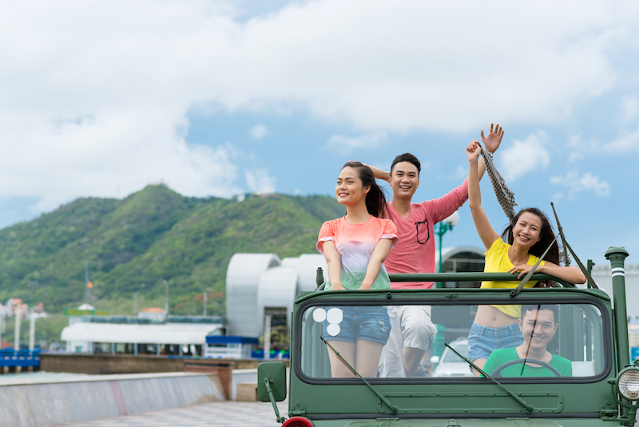
Travel has the ‘feel good factor’!
Going on holiday makes us feel good.
There is evidence to suggest that when you help others, it can promote physiological changes in the brain linked with happiness.
So, by helping people to travel the world and have incredible holidays, your own personal wellbeing will be enhanced, and you will feel happier in everyday life!

Slide 9
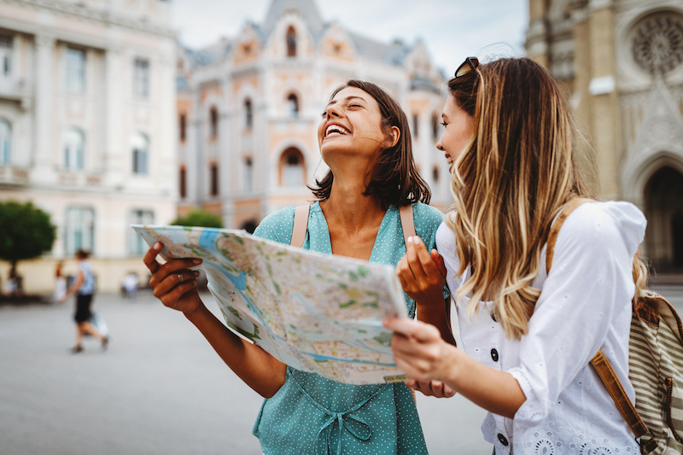
You gain skills for life
By studying travel and tourism and working in the travel and tourism industry you will gain a range of valuable skills that you will use throughout your life.
Many of these skills are transferable skills, meaning that you can use them in a number of different jobs, both within and outside of the travel and tourism industry.

Slide 10

Skills gained by studying travel and tourism
Communication
Teamwork
Customer service
Analysing
Management
Listening
Problem solving
Leadership
Organisation
Work under pressure
Enterprise
IT

Slide 11
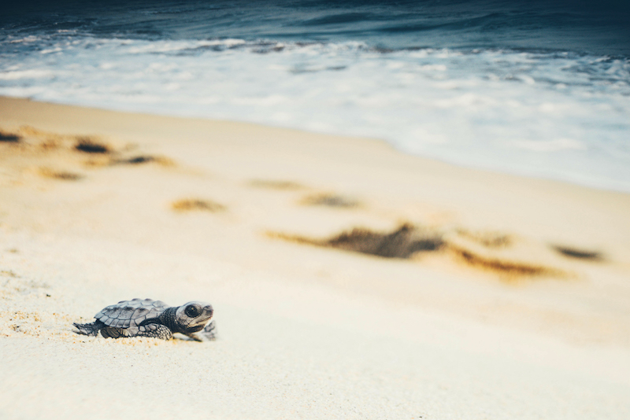
Help to make the world a better place!
Travel and tourism can help to teach us about different cultures and about the way that people live in different parts of the world.
Travel and tourism can teach us about the world that we live in and how better to take care of it.
There are so many ways that you can help to make the world a better place by studying travel and tourism.

Slide 12

By studying travel and tourism you are opening yourself up to an exciting world of opportunities, where the possibilities are endless….

Slide 13
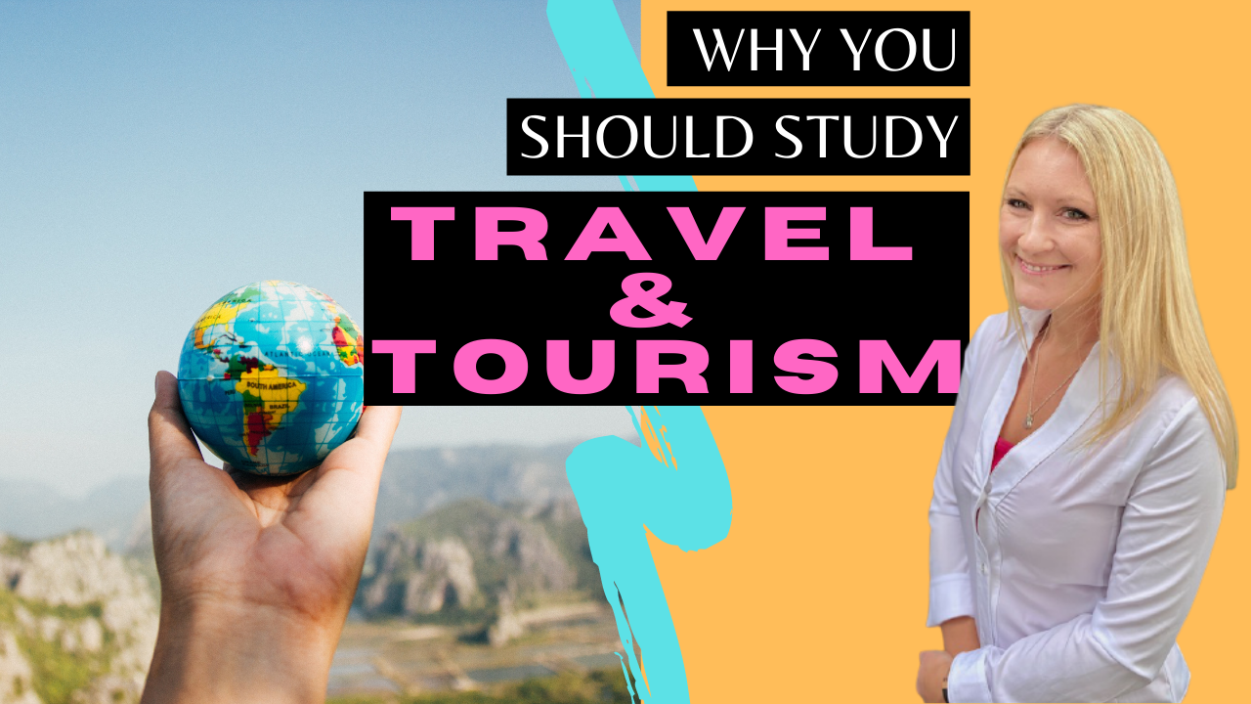
Learn more with Tourism Teacher!
Dr Hayley Stainton makes studying travel and tourism FUN and EASY!
Get excited about the travel and tourism industry and help to enhance your grades by subscribing on YouTube- https://www.youtube.com/tourismteacher

