Slide 1

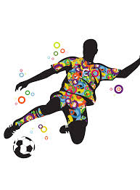
HSFC – BTEC Sport Preparatory Work 2026
This pack covers all key content from Unit 1: Anatomy and Physiology.
Complete the accompanying worksheets.
Bring your completed work with you on your first day.
We’re excited to welcome you to BTEC Sport!

Slide 2
Sporting Profile
Create a personal sporting profile that includes:
Your name and current school.
Sports you currently play (school/club/individual).
Positions/events you compete in.
Role models or athletes you admire and why.
What are you most looking forward to studying in BTEC Sport?
Are you more interested in practical performance, fitness training, or the science behind sport
Do you have any career aspirations in sport (e.g., coaching, physiotherapy, teaching, sports science)?
What support do you think will help you succeed in this course?

Slide 3
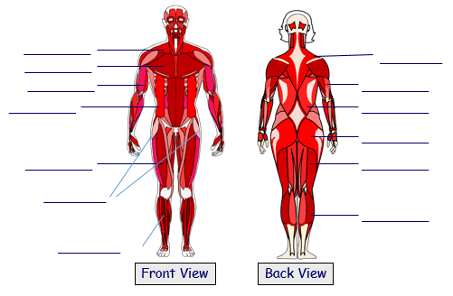
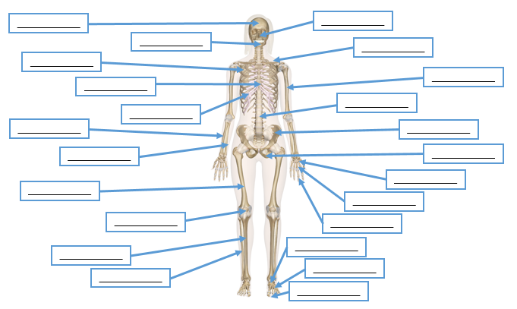
BTEC SPORT Unit 1: Anatomy & Physiology
Functions of the skeletal system:
1) ___________________________
2) ___________________________
3) ___________________________
Ligaments:
Tendons:
Antagonistic pairs: _____
_____________________
Agonist: _____________
Antagonist: ___________
Example: _____________ _____________________
Muscle fibres __________ _____________________
Type 1: _______________
Type 2a:______________
Type 2x: ______________
Highlight:
Long bones
Short bones
Irregular bones
Flat bones
Types of joints:
___________________________
___________________________
___________________________
___________________________
Flexion – _____________________________________
Extension – _____________________________________
Abduction – _____________________________________
Adduction - _____________________________________
Rotation – _____________________________________
Circumduction – _____________________________________
Plantar-flexion – _____________________________________
Dorsi-flexion – _____________________________________
EXAM QUESTION: Explain how the muscular and skeletal systems work together to kick a football: (6 marks)

Slide 4
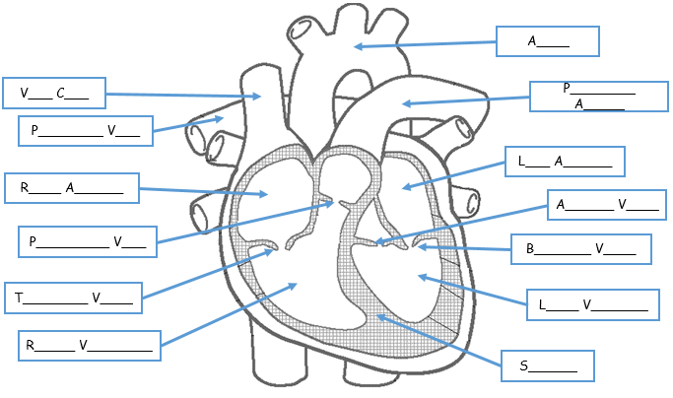
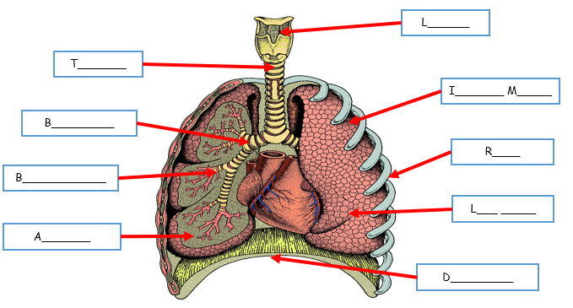
Functions of the cardiovascular system:
1) ______________________________
2) ______________________________
3) ______________________________
Blood vessels:
Arteries: ____________________
Veins: ______________________
Capillaries:__________________
Vasodilation: _____________________
Vasoconstriction: __________________
Blood pressure: ____
____________________________________‘Healthy’ BP:_______
Components of blood:
Red blood cells: ___________________
White blood cells: __________________
Platelets: _________________________
Plasma: __________________________
Short term effects of exercise:
Muscles? ______________________________________________
Breathing? _____________________________________________
Heart? ________________________________________________
Your heart beats in two phases:
Phase 1 – Systole: _________________________________
_______________________________________________
Phase 2 – Diastole: ________________________________
_______________________________________________
Aerobic respiration: ______________________________________
Sporting example: _______________________________________
Anaerobic respiration: ____________________________________
Sporting example: _______________________________________
Oxygen debt: _____________________________ ________________________________________
Gaseous exchange: ________________________ ________________________________________ ________________________________________
Vital capacity: ___________________________________
Tidal volume: ____________________________________
EXAM QUESTION: Explain how deoxygenated blood gets oxygenated again. (6 marks)

Slide 5
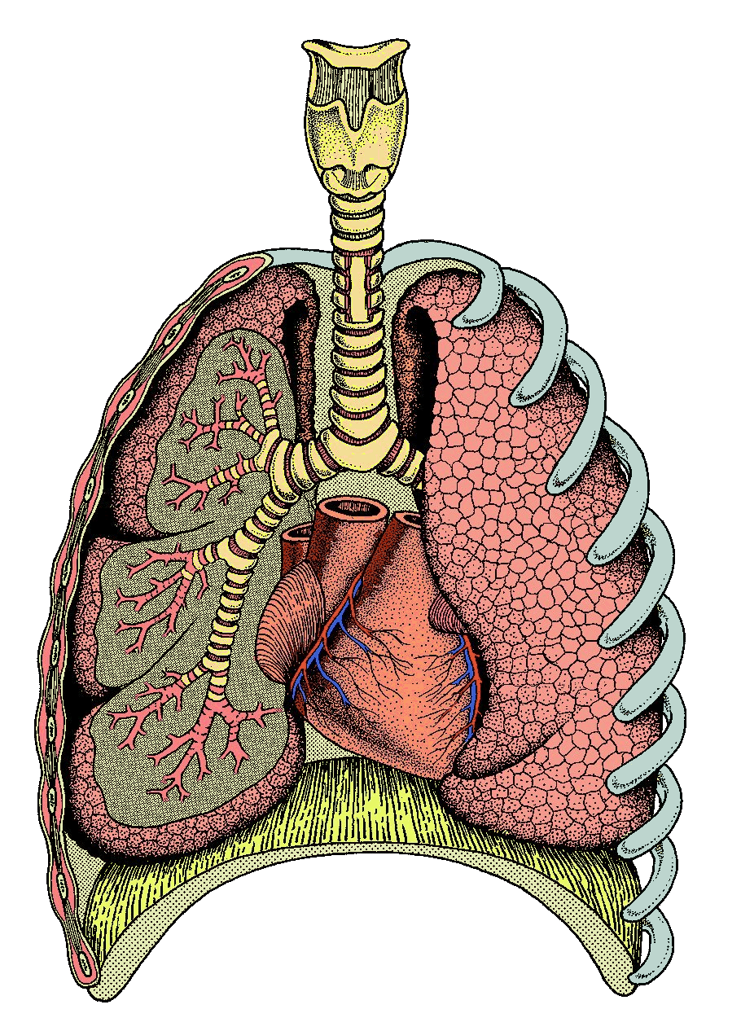
L______
T_______
I_______ M_____
B_________
R____
B____________
L___ _____
A_______
D_________

Slide 6
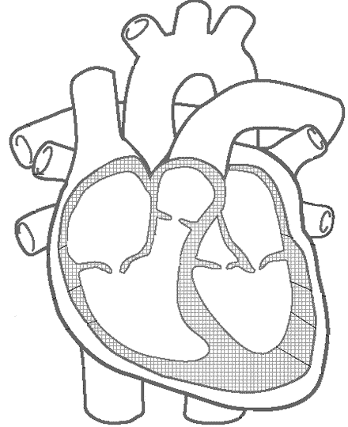
A____
V___ C___
P________ A_____
P________ V___
L___ A______
R____ A______
A______ V____
P_________ V___
B_______ V____
T________ V____
L____ V_______
R_____ V________
S______

Slide 7
Responses and Adaptations to exercise
Responses | Adaptations
Muscular system
Skeletal system
Cardiovascular system
Respiratory System
Energy Systems

Slide 8
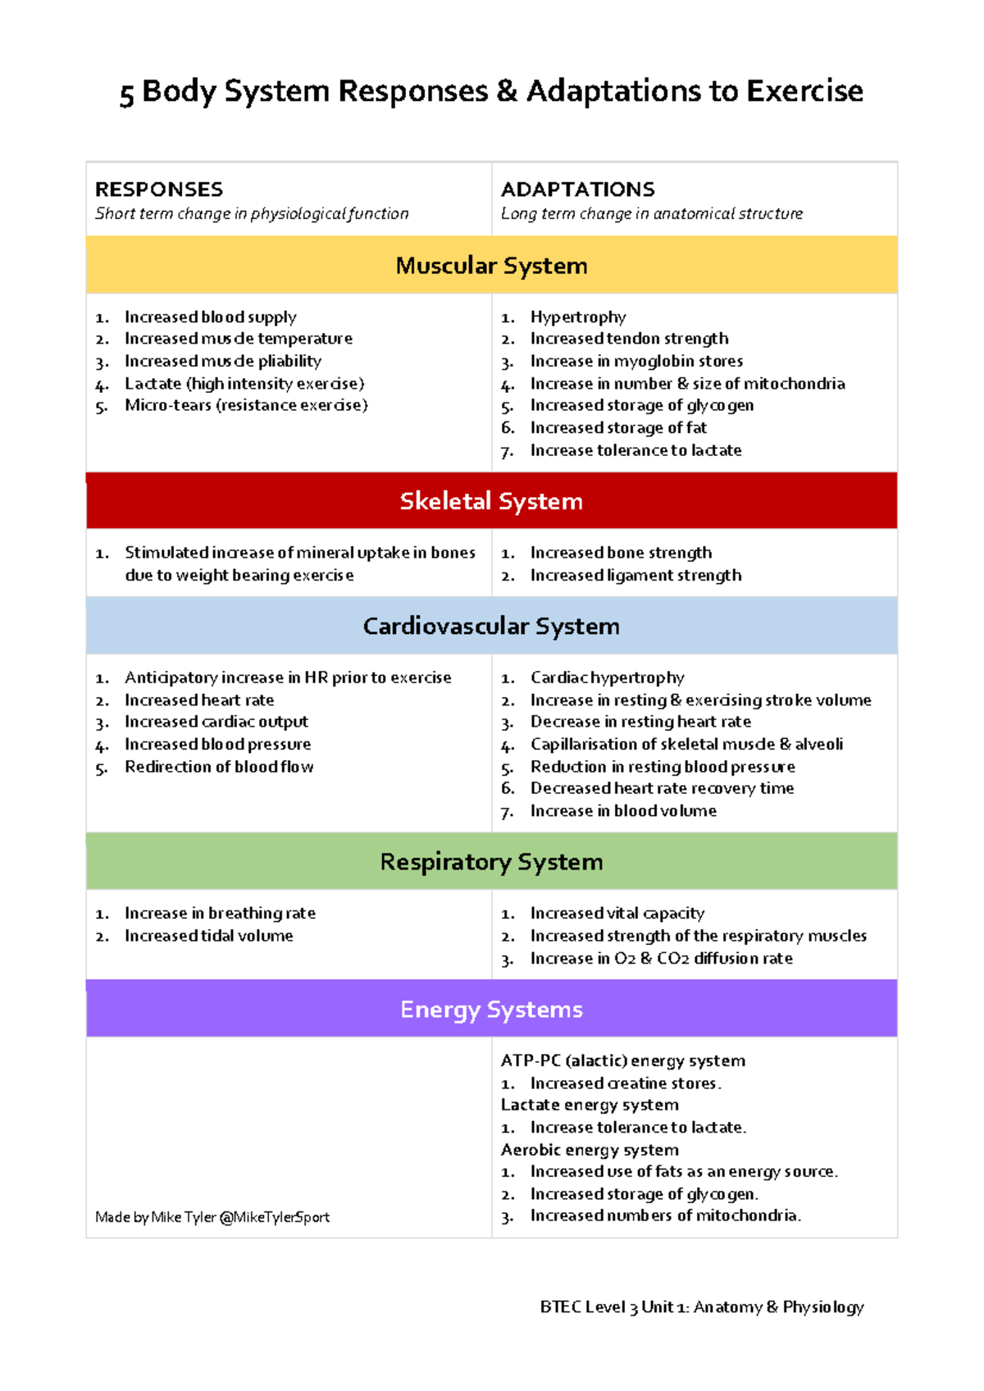
Self Assessment of your learning:
Responses and Adaptations to exercise are some of the most important areas of learning in Unit 1 Anatomy and Physiology

